Slide 1
A guide to this template
The UF Graduate School team assembled this template with suggested content for your graduate program orientation.
This template was created utilizing best practices collected from other UF graduate programs.
Thank you to the UF Clinical Psychology Program for sharing their materials with us for use in the development of this template.
This orientation should be in addition to your students attending GradStart.
Please use this link to be added to GradStart as a faculty/staff member.
Finally, we highly encourage you to share this slides with your students so they can refer to them.

Slide 2
[Graduate Program] Orientation
[Date]
[Names and titles of individuals leading orientation]

Slide 3
Student Introductions
If feasible, you can introduce your students to each other via slides. See example.
You could also consider small groups or another icebreaker, etc.
Ice breaker examples:
Research Bingo: Create a bingo card with different research-related topics or skills (e.g., "Has presented at a conference," "Speaks more than two languages," "Has worked in a lab"). Students mingle to find someone who matches each square, helping them discover shared interests and experiences.
Academic Bucket List: Ask students to share one thing on their "academic bucket list" (e.g., publishing a paper, attending a specific conference, learning a new methodology). This can spark discussions about goals and aspirations.
The “What’s Your Research?” Game: Each student explains their research interest in just 60 seconds. Afterward, others can ask questions or share related insights. It’s a great way to practice succinctly explaining complex ideas.
Shared Challenges: Have students pair up and discuss one challenge they anticipate facing in graduate school. Then, regroup and have each pair share their challenges with the whole group. This can foster a sense of support and understanding.
“I’m an Expert In…”: Each student shares something they're an expert in, whether it's related to their field of study or a hobby. This can lead to interesting conversations and highlight the diverse expertise within the group.
Favorite Failure: Ask students to share a significant failure in their academic or professional life and what they learned from it. This can normalize failure as part of the learning process and create a supportive environment.
Research Roadmap: Have each student create a quick visual or verbal "roadmap" of their academic journey, including where they started, key milestones, and where they hope to go. Share these with the group to see the varied paths everyone has taken.

Slide 4
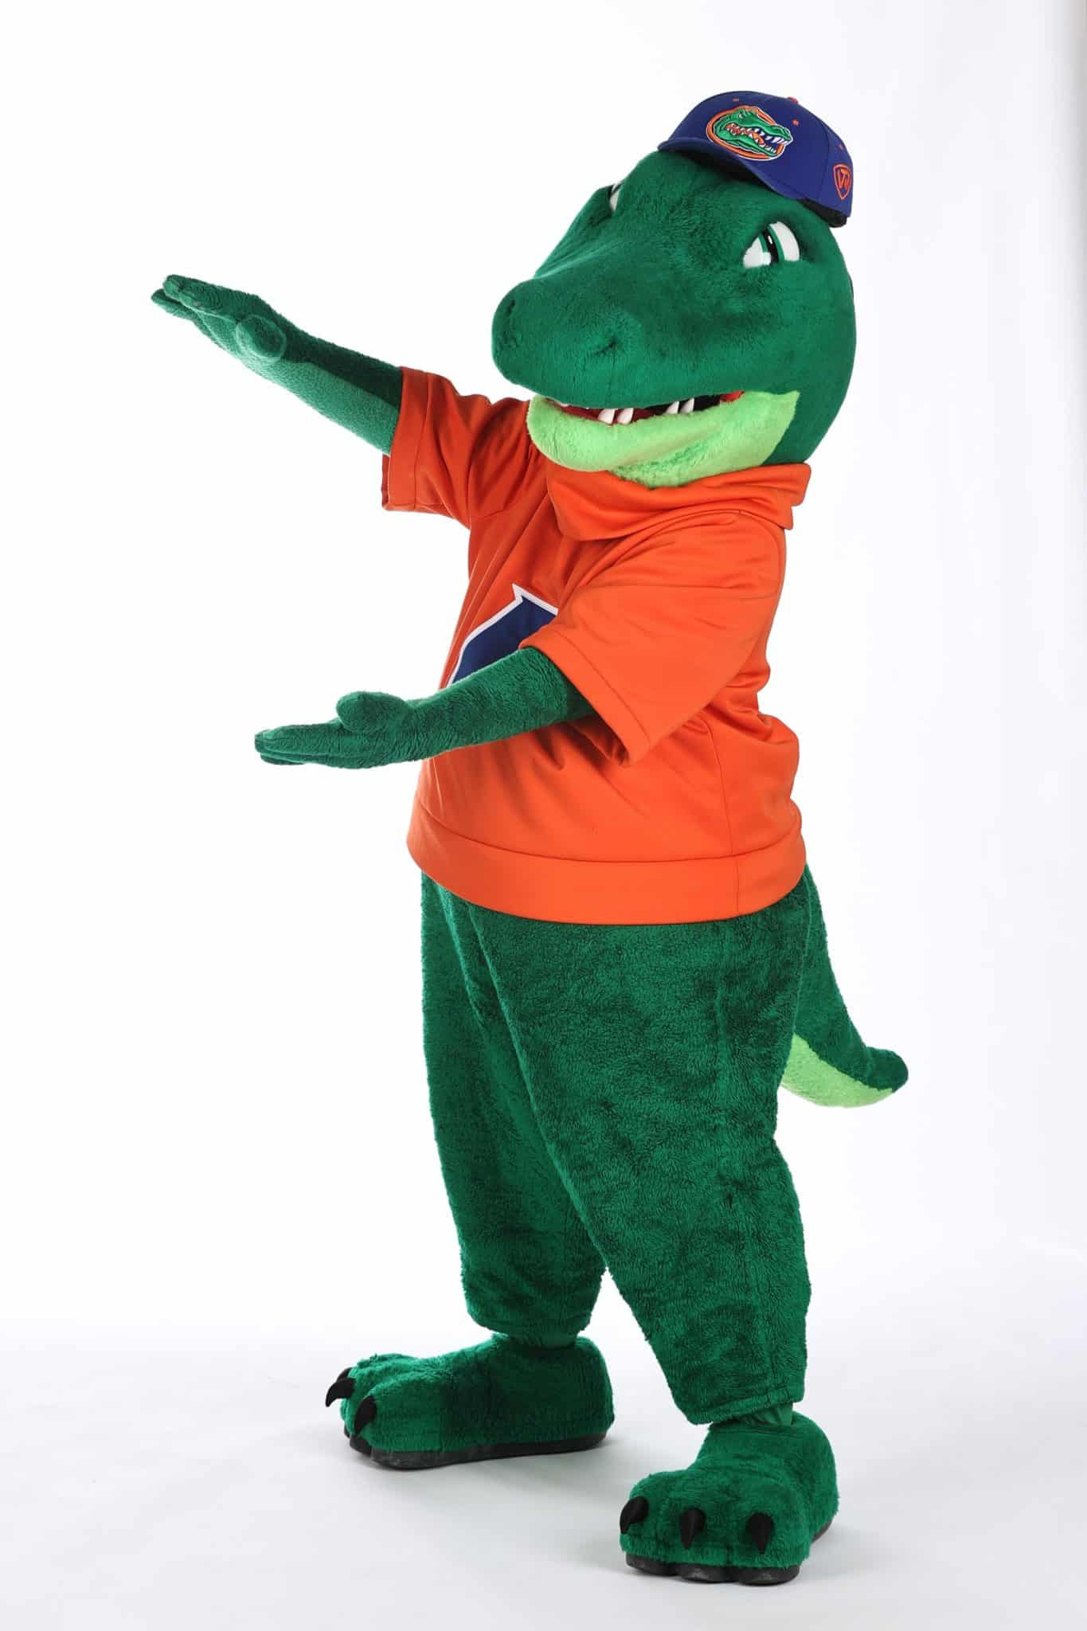
Example Student Introduction: Albert Gator
University of Florida, Gainesville
B.S. in Biochemistry and Molecular Biology
Minor in Statistics

Slide 5
Transition Slide – Welcome Home!
Begin the introduction to your program
Consider including something which distinguishes your program:
Quotes from alumni or leaders
Outcomes for your students (where have they gone after the program)
Other key strengths/identity of your program

Slide 6
Who we are
Use the following slides to introduce students to program leadership and administrators
We included some examples for inspiration

Slide 7
[Staff name and title (e.g., Graduate Advisor)]
Your #1 point of contact
Coordination of academic activities
Management of student documentation and records
Course registration
Admissions logistics
Program events such as orientation
Email: xxxxx@ufl.edu

Slide 8
[Faculty name & title (e.g., Graduate Coordinator or Program Director)]
Academic background of faculty member
Curriculum and teaching development
Thesis and dissertation oversight
Admissions and curriculum committee
Mentor evaluations

Slide 9
[Other name & title]
Include any other faculty or staff who are attending the orientation and whom you would like the students to know and why

Slide 10
About your department/unit

Slide 11
Facts about the department/unit
College of which the program is a part
Other graduate programs in the unit
Other relationships the program has at the university
Numbers which describe your program and of which you are proud
Faculty
Students
Graduation rate
Average student publications
Internship placement
Alumni job placements
Rankings

Slide 12
Administrative Support
Include names, headshots, titles, and responsibilities of any relevant administrative support for the department/unit

Slide 13
Department/unit/college leadership
Include headshots and titles of any other leadership you would like the students to know

Slide 14
Funding information
You could describe how the program/unit/department is funded to provide context to how the students are funded

Slide 15
Graduate Program Introduction

Slide 16
Describe the goals of your program
Use this slide to describe the goals of your program and what your students gain by completing it. See example below.
Completing this degree program requires producing original research, documented in a thesis or dissertation, and successfully defending the work before experts in the field.
Our program prepares you to
Investigate meaningful, empirically testable questions
Contribute to the advancement of knowledge through research
Be marketable in various career paths such as XXXX

Slide 17
Timeline and milestones (edit to fit your program)
1st Year
2nd Year
3rd Year
4th Year
5th + Years
Core Assessment
Advanced Research
1st Year Project
Present at Symposium
Begin Job Search
Committee Formation
Qualifying Exam
Dissertation Defense
Required Coursework

Slide 18
Planning Coursework
Guide your students on how to identify which courses they will take, for example you could include
Talk to your mentor
Review the program handbook (include link)
Review the course schedule page (include link)
UF Schedule of Courses

Slide 19
Funding available to students (please modify to include how your students are supported)
Funding Source | Duties | Provided to Student
Research assistantship funded by department | Specific tasks defined by contract, 20 hrs/week | Tuition, fees (if applicable), stipend, health insurance = at least $38,000/year (varies according to stipend and residency)
Research assistantship funded by mentor’s grant | Specific tasks defined by grant, 20 hrs/week | Tuition, fees (if applicable), stipend, health insurance = at least $38,000/year (varies according to stipend and residency)
Individual fellowship (e.g., NSF GRFP, NIH F31) | No associated duties but full-time occupation in research and studies expected | Tuition, fees (if applicable), stipend, health insurance = at least $38,000/year (varies according to stipend and residency)
Institutional fellowship (T32) | No associated duties but full-time occupation in research and studies expected | Tuition, fees (if applicable), stipend, health insurance = at least $38,000/year (varies according to stipend and residency)
Teaching assistantship | Specific tasks defined by contract, 20 hrs/week | Tuition, fees (if applicable), stipend, health insurance = at least $38,000/year (varies according to stipend and residency)

Slide 20
Registration Requirements
Your number of credits is determined by your funding source
If you are not registered for the correct number of credits, your waiver will not process
Fellows wanting to take fewer credits must request a petition
Do not ask your peers about registration! Follow the chart
See “Registration Requirements” in Graduate Regulations
Credits Required | Fall | Spring | Summer
Assistantship (0.5 FTE) | 9 | 9 | 6
Fellowship | 12 | 12 | 8

Slide 21
Graduate Assistantships

Slide 22
Include information on 9 and 12 month assistantships, if applicable
Departments and graduate programs should be familiar with expectations, requirements, and benefits for graduate assistants. More information, including guaranteed sick/leave days, Paid Family Leave, and procedures to follow can be found here:
https://www.ufgau.org/contractfaq.html or https://admin.hr.ufl.edu/compliance/employee-relations-and-ethics/union-negotiations/gau-collective-bargaining-agreement/

Slide 23
Your First Year

Slide 24
Include a sample schedule. Indicate what is required vs. elective
Fall | Spring | Summer
Course 1 | Course 1 | Course 1
Course 2 | Course 2 | Course 2
Optional: | Optional: | Optional:
Credits: | Credits: | Credits:
Typical teaching/research expectation (if applicable):
Link to course catalog:

Slide 25
First Year Timeline
Fall
Choose rotations
2nd week September
Spring
Choose lab, inform graduate coordinator
1st week of April
Summer
Establish dissertation committee
Last week of July
Below are some examples of milestones/expectations
Attend dept retreat, October
Complete IDP
Attend professional society conference

Slide 26
Good Academic Standing
Students are often surprised to know that they must keep at least a 3.0 GPA
Outline expectations and consequences of going below 3.0 GPA
Encourage meeting with instructors early if they foresee any issues/concerns
Policy: https://gradcatalog.ufl.edu/graduate/regulations/

Slide 27
Mentorship

Slide 28
Mentorship
Include here what expectations students should have of their major advisors/chairs.
Expectations include:
Guidance on meeting academic requirements and departmental expectations
Financial and/or intellectual support for research project
Guidance on mentee professional development and available resources
Monitors academic progress
Approves leave time, work schedule
Other expectations can also include:
Career guidance
Role model and part of support system
Coach and professional sponsor
Include any departmental/program support that can help, including peer mentors, student groups, etc.

Slide 29
Things to Do Now

Slide 30
This will vary by dept, but might include several slides outlining:
Instructions on changing to FL residency when applicable- can affect student’s tuition costs
https://registrar.ufl.edu/services/residency
Who students should meet: lab members, other graduate students, peer mentor, etc
Any applicable trainings
Responsible conduct of research, FERPA, environmental health and safety
How to use eLearning: https://elearning.ufl.edu/student-help/keep-learning/quickstart-guide-for-students/
How to obtain free Gatorcloud software (e.g. Office 365, dropbox):
https://it.ufl.edu/services/search/gatorcloud
Completing IDP and requirements
Required for doctoral students. More info:
https://grad.ufl.edu/work/idp-policy/
https://gradadvance.graduateschool.ufl.edu/planning-resources/idp/

Slide 31
Other things to know

Slide 32
Tips to have a successful graduate school experience
Examples include expanded information on how to:
Utilize resources
Seek help/assistance
Time management
Develop initiative and independence
Seek and incorporating feedback
Focus on health and wellness
Address challenges with faculty/advisors (chain of command, university resources)

Slide 33
Campus resources
You may want to highlight several campus resources. Some suggestions include:
Graduate Student Success Center: https://success.grad.ufl.edu/
Many resources for professional development, engagement, mentoring, and others
Roadmaps to develop core competencies in graduate school: https://gradadvance.graduateschool.ufl.edu/planning-resources/
GradCare: https://graduateschool.ufl.edu/gss/gradcare/
Chris Walker can help graduate students navigate solutions for issues they may be facing
Career Connections Center: TBA
Gatorwell: https://gatorwell.ufsa.ufl.edu/
They provide 1-1 wellness coaching on a variety of areas including time management and prioritization, stress management, sleep habits, social connection, and others.
Counseling and Wellness Center: https://counseling.ufl.edu/
Gainesville information: https://www.visitgainesville.com/explore/

Slide 34
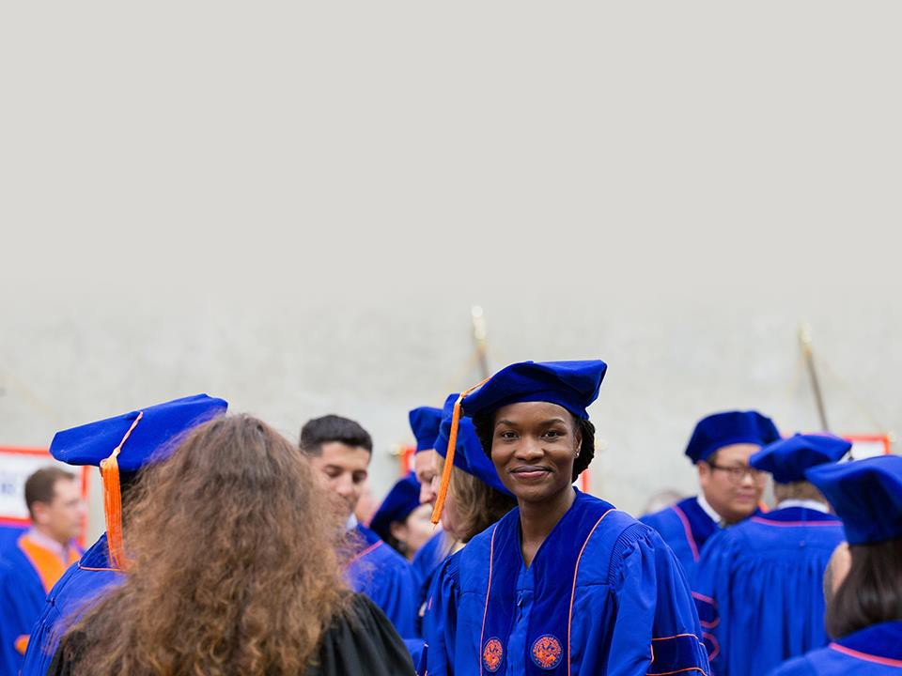
The University of Florida Graduate School helps graduate students thrive through manifold initiatives in academics, diversity enhancement, funding, international outreach, and professional development.
Don’t miss out! Keep up on such game-changing opportunities by following the Graduate School social media and listserv messages.

